Slide 1
Project Title
Name: Alam Rithika
Matrix: 2202550F
Supervisor: Dr Chia

Slide 2
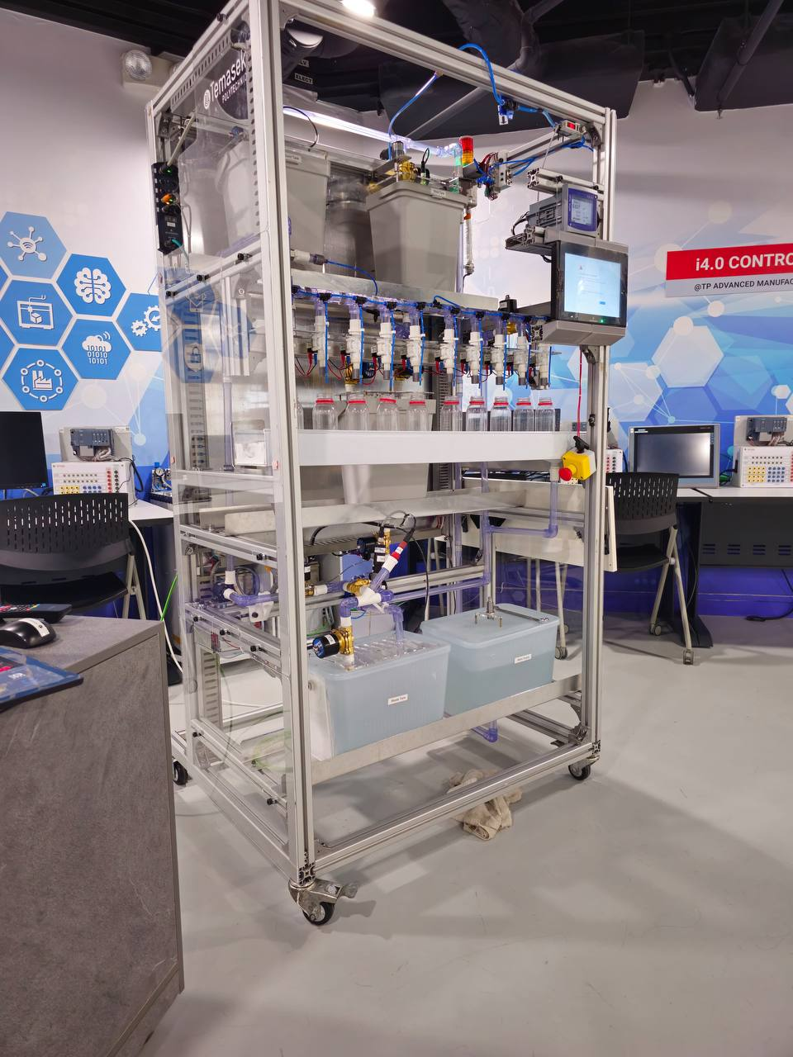
Background
• Develop a comprehensive dashboard to observe machine performance, OEE (Overall Equipment Effectiveness) metrics, and anomaly detection, alongside monitoring the carbon emissions of a saline production machine.
• Aim to significantly reduce the environmental impact by actively managing and minimizing carbon emissions associated with production processes.
• Enhance operational efficiency through real-time data analytics, ensuring optimal machine performance and energy use.
• Ensure the consistent quality of saline solutions produced by implementing continuous, real-time adjustments and rigorous monitoring.

Slide 3


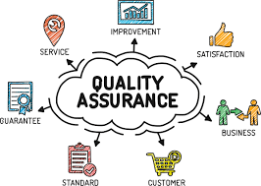

Targeted Users
Factory Managers: Primary users who oversee production operations
Environmental Officers: Individuals responsible for ensuring the production processes comply with environmental regulations and sustainability goals.
Quality Assurance Teams: Teams dedicated to maintaining the quality of the saline solution.
Maintenance Personnel: Technicians who utilize the dashboard to receive alerts and insights about potential anomalies and machine performance issues
Notes:
Factory Managers: Primary users who oversee production operations, ensuring that everything runs efficiently and adhering to quality standards.
Environmental Officers: Individuals responsible for ensuring the production processes comply with environmental regulations and sustainability goals.
Quality Assurance Teams: Teams dedicated to maintaining the quality of the saline solution, ensuring it meets all required specifications.
Maintenance Personnel: Technicians who utilize the dashboard to receive alerts and insights about potential anomalies and machine performance issues, facilitating timely maintenance.

Slide 4
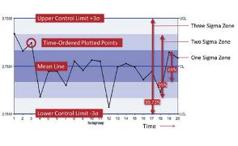
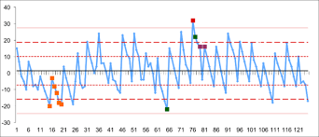
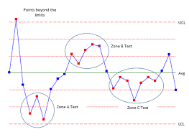
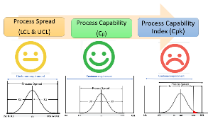
Features
1. Tab ‘Past Performance’ is divided into 3 sub tabs ‘Machine Data’, ‘OEE Data’, and ‘SPC Analysis’.
2. SPC features:
Control Limit Calculation: Calculates control limits (UCL, LCL) and centerline (CL) based on custom inputs or standard deviation.
Process Capability (Cp, Cpk) Calculation: Computes process capability indices.
Out-of-Control Detection: Identifies points outside control limits.
SPC Rules Detection: Implements additional SPC rules like 2 of 3 points beyond 2 standard deviations,etc.
SPC Chart Rendering: Generates line charts with control limits, including special indicators for rule violations.
Capability Gauges: Visualize gauges for Cp and Cpk values.

Slide 5
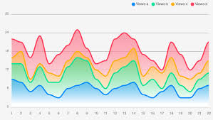
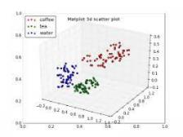
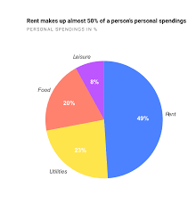
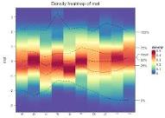
Features
3. Generate PDF reports for SPC analysis
4. Dynamic Filtering: Allows users to dynamically feature and time filters
5. Exception Management. Provides error feedback when data fetching or processing fails.
6. Annotation Feature: Adds max and min value annotations on plots. Able to freehand draw on all the plots.
7. Data Visualization using these plots:
Time Series Line chart
Area Chart
Pie Chart
Heatmap
3D Scatter Plot
Box Plots
Density heat map
8. These plots have the ability to zoom in and
Zoom out and 3d plots can rotate as well.

Slide 6
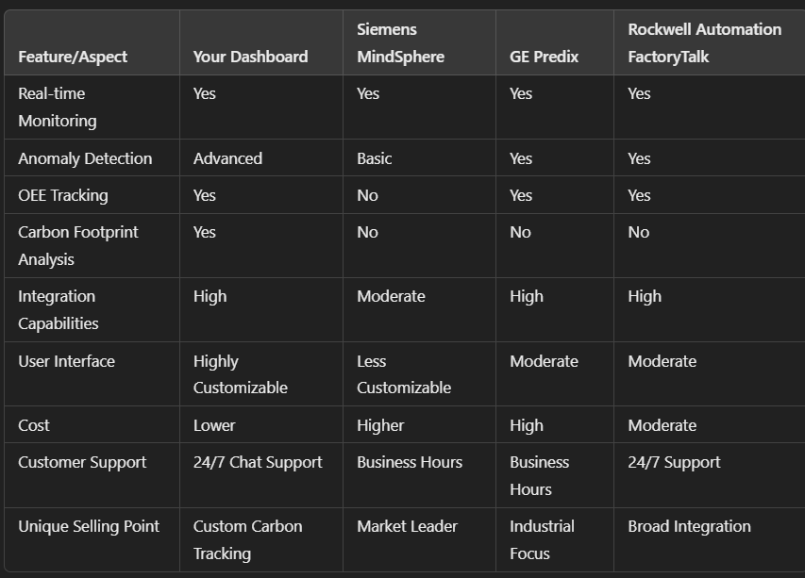
Existing Products

Slide 7


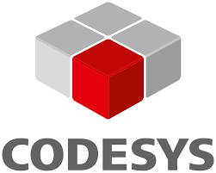


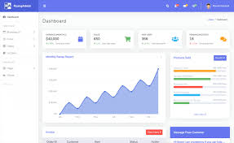

System Architecture
Machine
DashBoard
Pycharm Community

Slide 8
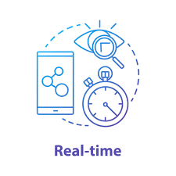
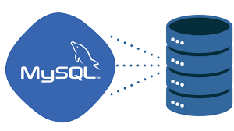

Assumptions
Performance Standards: The dashboard is assumed to perform adequately under normal operational conditions, handling updates and data refreshes without significant delays.
Real-Time Data Availability: The data being pushed from the machine to the database is assumed to be available in near real-time, allowing the dashboard to provide up-to-date information without significant delays.
Database Scalability: The MySQL database is capable of handling the growing amount of data being generated by the machine without performance degradation.

Slide 9

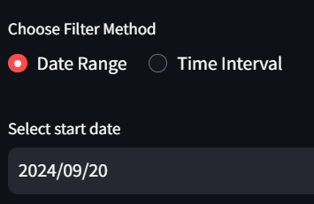
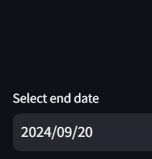
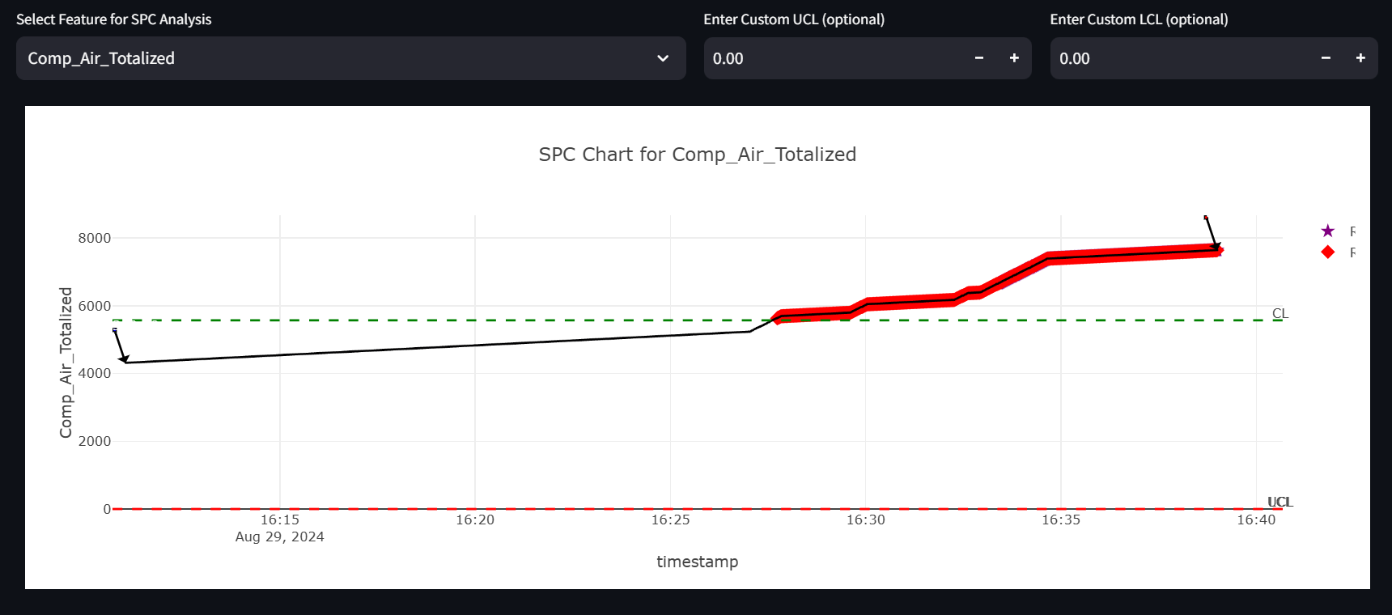


User Guide
From Main Page, navigate to ‘Past Performance’ tab.
Three Sub tabs will appear under the main tab; SPC Analysis, Machine Data, OEE Data.
In all three sub tabs, there is data filtering option, where user can choose either ‘ Date Range’ or ‘Time Interval’.
In SPC Analysis Tab, line chart is generated with control limits. Also includes special indicators for rule violations.
Clear Annotation button helps remove all the annotations user made.
While Generate SPC report gives you a PDF with all the SPC related details that you can see from the chart.

Slide 10
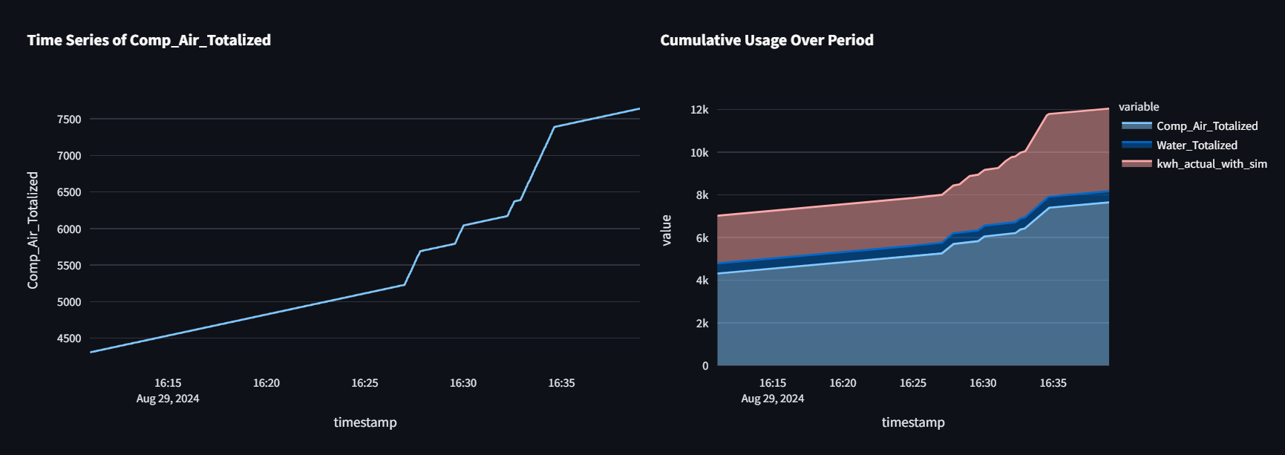
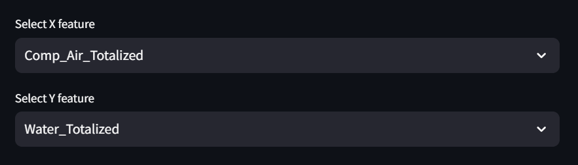
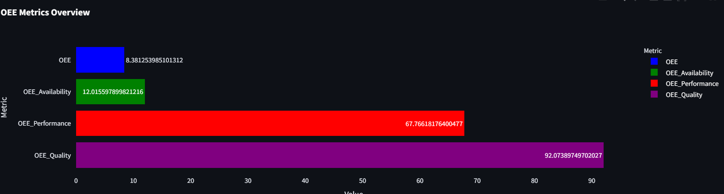
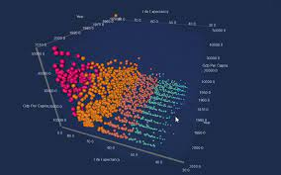
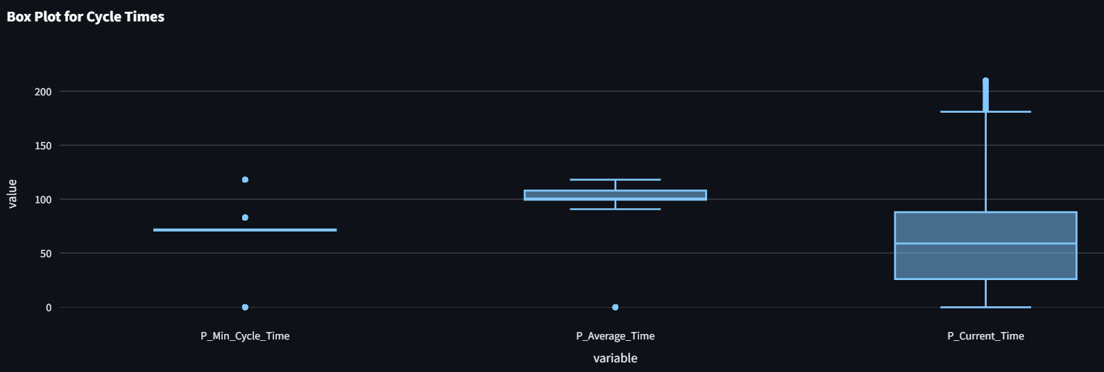
User Guide
Next is the Machine Data sub tab which consists of plots.
There is 2d and 3d plots in this sub tab.
As well as being able to select the feature you want to use to plot.
The next sub tab contains OEE and CO2 related data visualizations.
Variety of different charts available

Slide 11
Limitations
Data Dependency: The dashboard's functionality heavily relies on the continuous and reliable streaming of data from the production machine. Any disruptions in data flow or connectivity issues can lead to inaccurate or unavailable analytics.
Performance Scaling: While the current setup handles smaller datasets efficiently, scaling to handle larger data volumes or higher frequency updates may require optimization to maintain performance.
Real-Time Processing Limits: There might be a delay in the real-time display of data due to processing time, especially with complex calculations or during high data inflow.

Slide 12
Future Enhancement
Implement advanced data management solutions such as in-memory databases or real-time data processing frameworks like Apache Kafka or Apache Storm to handle higher data throughput.
Employ more robust error handling and recovery processes to quickly restore data flow after disruptions, minimizing downtime.
Leverage cloud services that can dynamically allocate resources based on the current load, ensuring that performance remains consistent as dataset sizes increase.
Customization Features: Provide users with more customization options for the dashboard, allowing them to tailor the interface and the analytics to their specific needs.

Slide 13
Challenges / Lessons Learnt
Challenge: Creating an intuitive and effective user interface that caters to all types of users, from technicians to management, ensuring that the dashboard is easy to navigate and understand.
Lesson Learned: Being open to making iterative changes based on user feedback and system performance data helped in refining the wesbite over time.
Challenge: As the scale of production increases, the volume of data also grows. Managing this effectively without causing delays in data processing or slowing down the system can be challenging.
Lesson Learned: Performance Optimization. Continuous profiling and optimization of the data processing and dashboard rendering code to handle larger datasets efficiently.

Slide 14
Thank You

